Slide 1
Outlier
Wind Speed
Max PAR
CO2

Slide 9
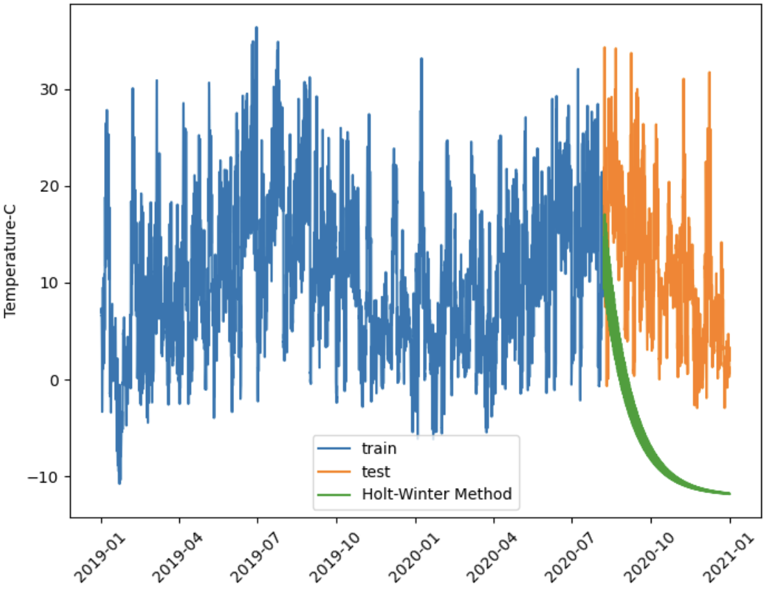
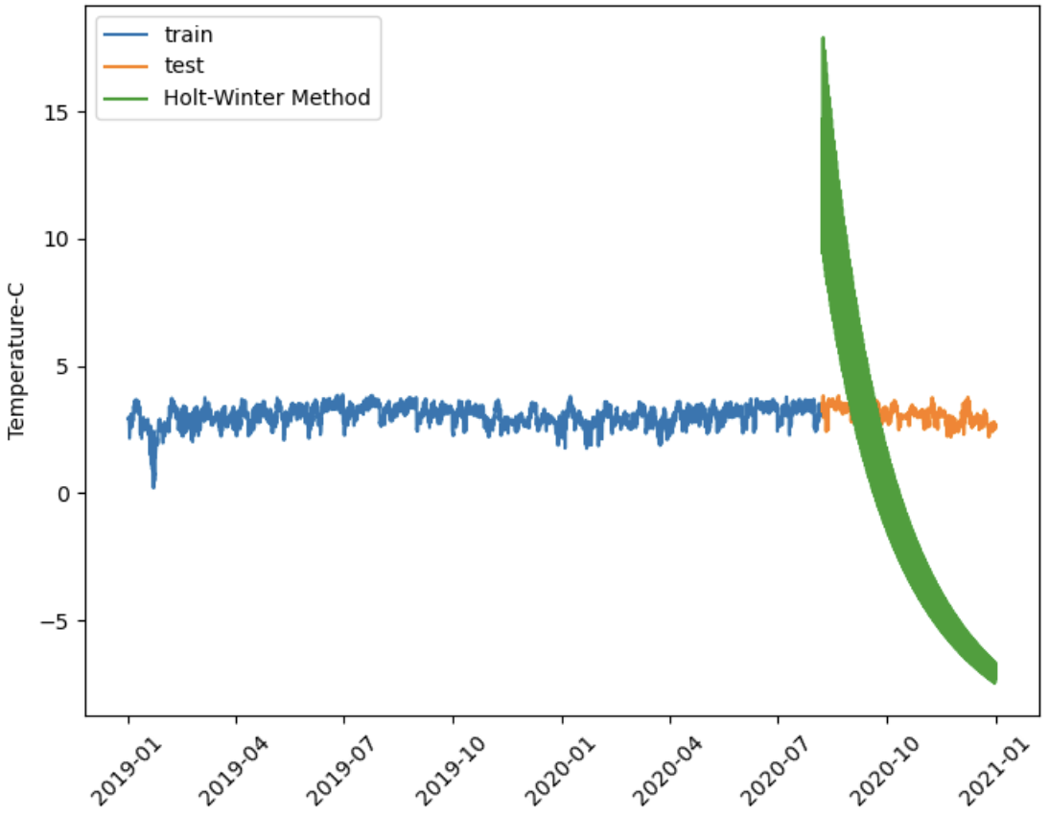
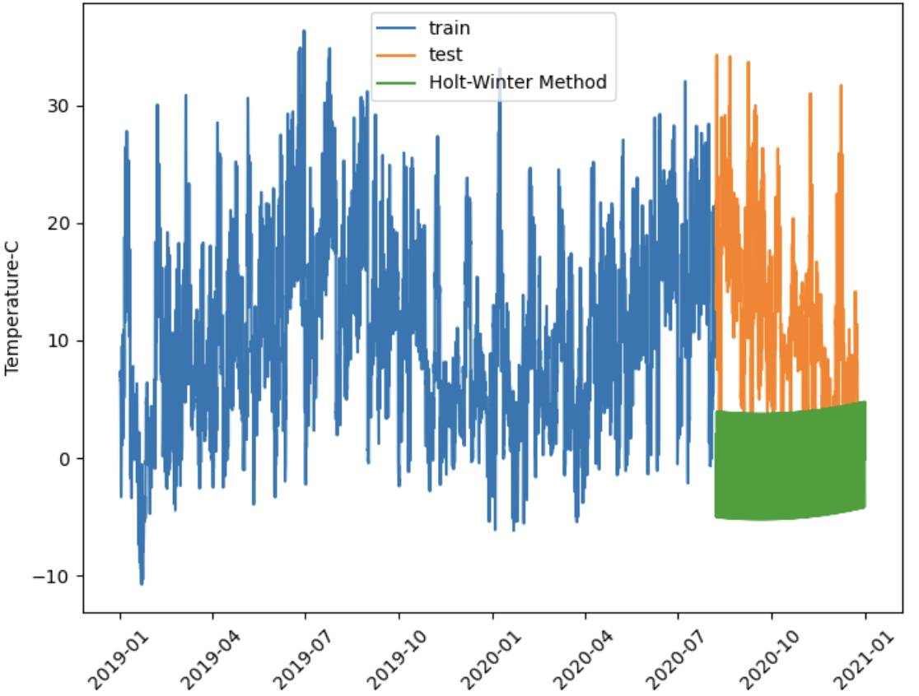
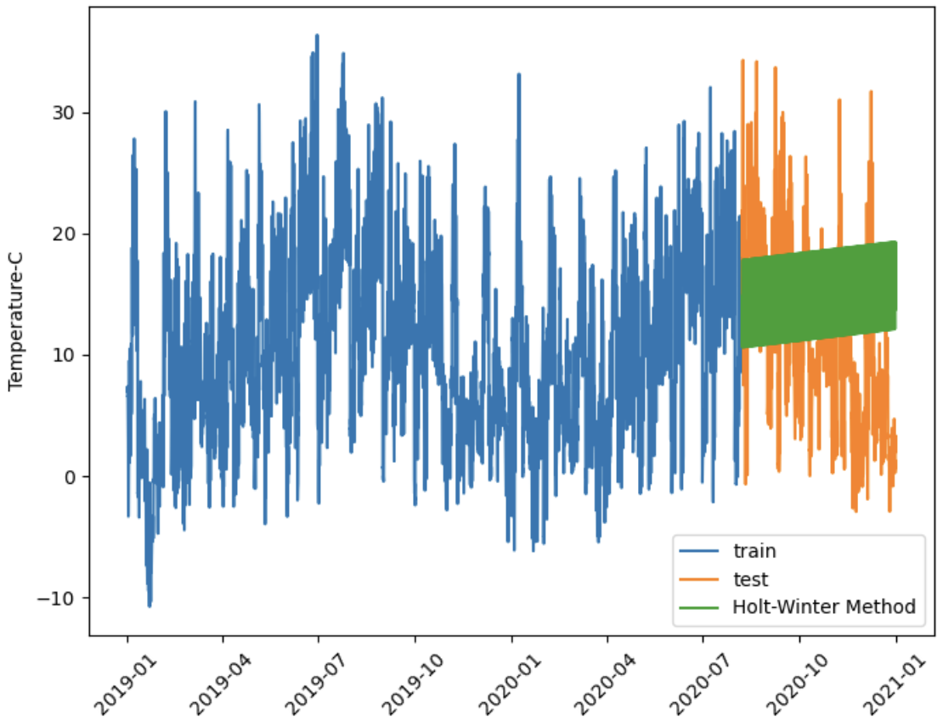
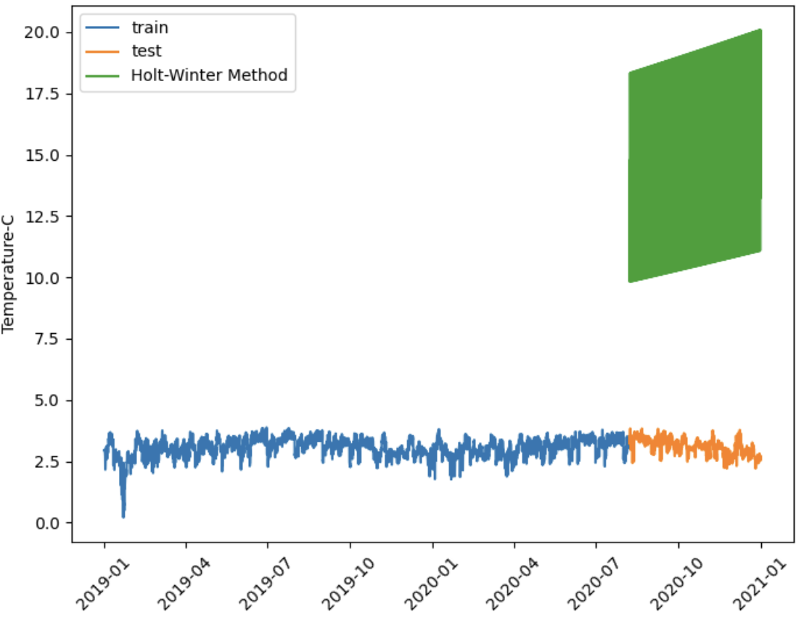
Raw(Mul)
Log(Mul)
1st diff (Add)
Raw(Add)
Log(Add)

Slide 10
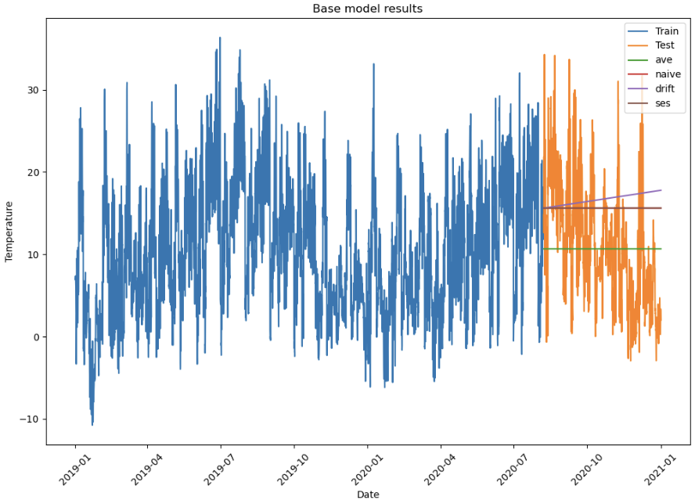

Slide 11
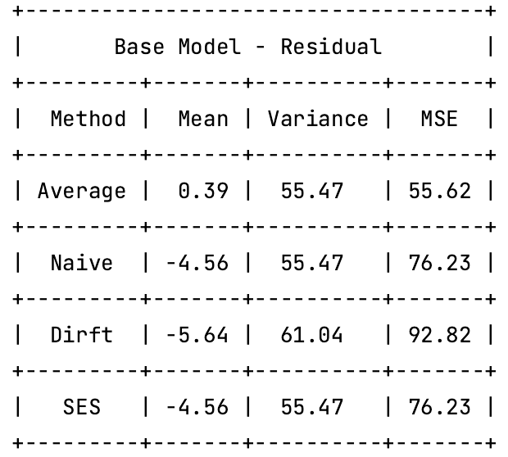

Slide 12
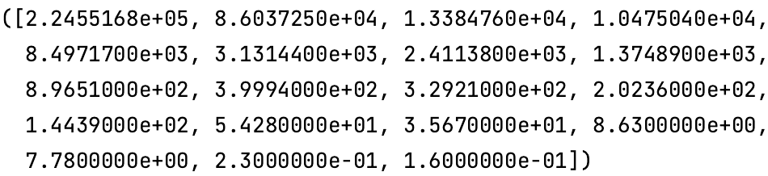
Singular values:
Condition number:
1,409,780.69

Slide 13
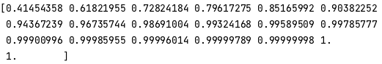
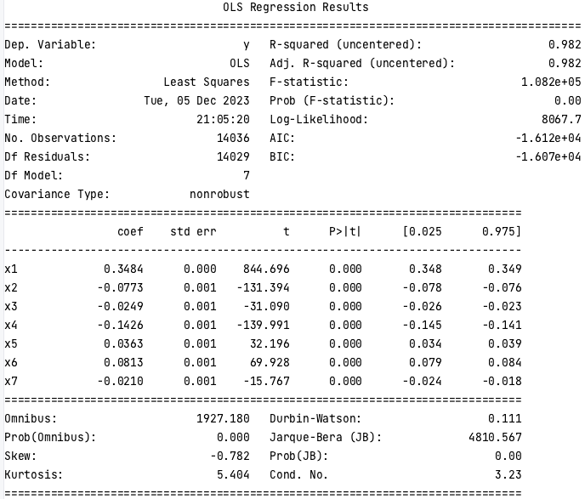
PCA

Slide 16
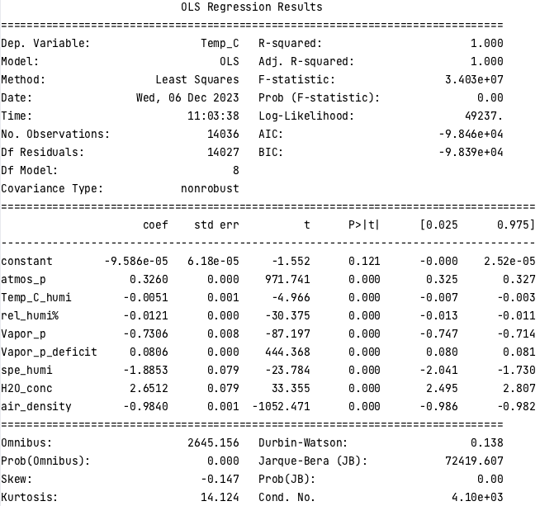
Backward stepwise regression

Slide 18
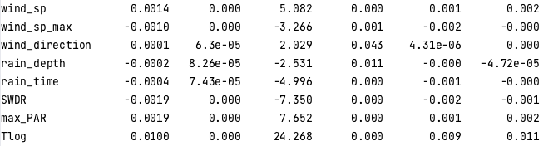
Remove | p-value | Adj_R2
\ | \ | 1.00
PAR | 0.79 | 1.00
Vapor_p_max | 0.33 | 1.00
CO2 | 0.09 | 1.00

Slide 19
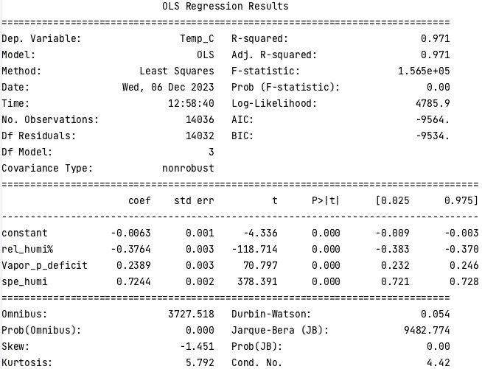
VIF

Slide 20
remove | VIF | Adj_R2
 |  | 1.00
Vapor_p_max | 14,403,743.53 | 1.00
H2O_conc | 1,664,251.75 | 1.00
Vapor_p | 18,405.61 | 1.00
PAR | 790.68 | 1.00
air_density | 304.34 | 1.00
Tlog | 40.65 | 1.00
Temp_C_humi | 24.89 | 0.97
wind_sp_max | 24.69 | 0.97
SWDR | 19.52 | 0.97

Slide 22
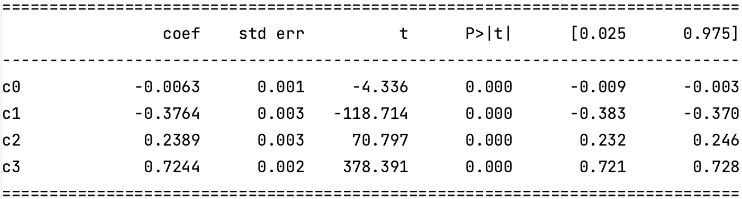
T-test
F-test

Slide 23
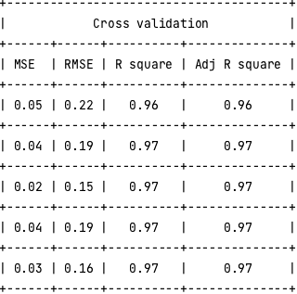

Slide 24
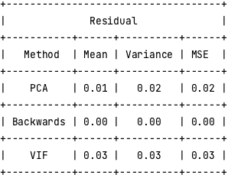

Slide 25
Raw
AR=1, MA=0

Slide 26
2 non-seasonal diff + 1 seasonal diff
MA = 1, AR = 0

